Slide 2
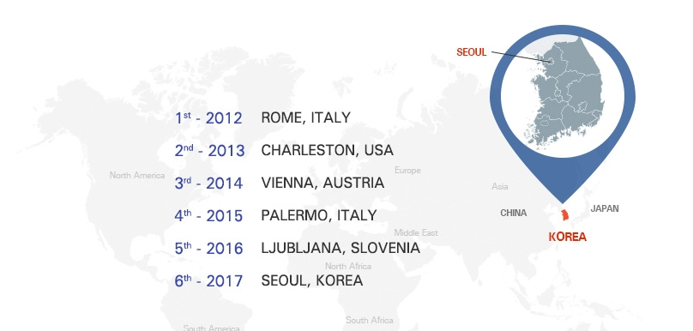
What’s ICCNU ?
Best event to learn the latest topics and technologies about neuromuscular imaging
International Society of Peripheral Neurophysiologic Imaging (ISPNI)’s first ICCNU held in Asia
Specialists in the rehabilitation medicine, neurology and radiology fields will gather together
Invited lectures & hands-on workshops will be presented by world-renowned faculty

Slide 3




ICCNU 2017 Overview
Title | 6th International Conference and Course on Neuromuscular Ultrasonography in conjunction with the 2017 KANMS SONO and KAPM Autumn Conferences
Date | September 21 (Thu) to 23 (Sat), 2017
Venue | Sheraton Seoul Palace Gangnam Hotel, Seoul, Korea
Organized by
Supported by
Official Language | English
Website | www.iccnu2017.org
Scale | 500 Participants (Overseas 200, Domestic 300) 35 Exhibition Booths
International Society of Peripheral Neurophysiologic Imaging (ISPNI)
Korean Academy of Neuromusculoskeletal Sonography (KANMS∙SONO)
Korean Association of Pain Medicine (KAPM)
Korean Society of Pain & Autonomic Disorders (KSPAD)

Slide 4
Call for Abstracts
Call for Abstracts
Closes June 23, 2017
Apply for
AWARDS & GRANTS

Slide 5
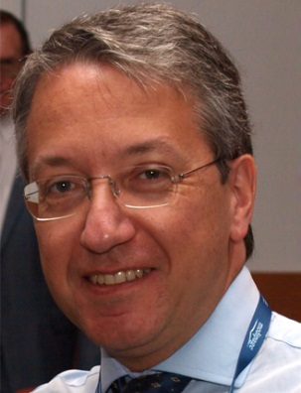
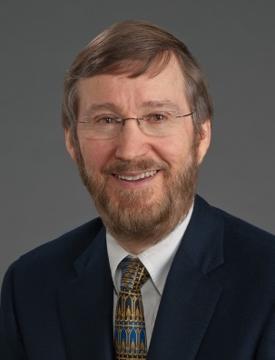
Scientific Program
Plenary Speakers
Carlo Martinoli, M.D.
Professor, Radiology University of Genoa Italy
Francis O. Walker, M.D.
Professor, Neurology Wake Forest School of Medicine USA
Topic-1A | Upper Extremity 1 |  | SIG-3 | Muscle Ultrasound
Topic-1B | Peripheral Nerve Disease |  | SIG-4 | Peripheral Nerve Trauma
Topic-2A | Upper Extremity 2 |  | SIG-5 | Comparison of Imaging and Electrodiagnosis
Topic-2B | Entrapment and Diabetic Neuropathy |  | Workshop-1A | Lower Extremity 1
Topic-3A | Spine |  | Workshop-1B | BTX-A Toxin (Upper Extremity)
Topic-3B | Cranial Nerves |  | Workshop-2A | Upper Extremity 1
Topic-4A | Lower Extremity 1 |  | Workshop-2B | BTX-A Toxin (Lower Extremity)
Topic-5A | Lower Extremity 2 |  | Workshop-3A | Upper Extremity 2
Topic-6 | New Ultrasound and MRI Technology |  | Workshop-3B | Cervical and Thoracic Spines
SIG-1 | Sonoelastography |  | Workshop-4A | Lower Extremity 2
SIG-2 | US-guided Radiofrequency |  | Workshop-4B | Lumbar Spine

Slide 6
Call for Abstracts
Online Submission (Oral, Poster) Closes June 23, 2017
JUN-23
Abstract
Submission
Deadline
JUL-23
Notification for
Abstract
Acceptance
AUG-18
Pre-registration
Deadline
Anatomy and US/MRI Imaging of Cranial Nerves
Anatomy and US/MRI Imaging of Muscle & Nerve in Lower Extremity
Anatomy and US/MRI Imaging of Muscle & Nerve in Upper Extremity
Entrapment Neuropathy
New Imaging Techniques
Peripheral Nerve & Muscle Disease
Ultrasound Imaging and Guided Injection of Spine

Slide 7
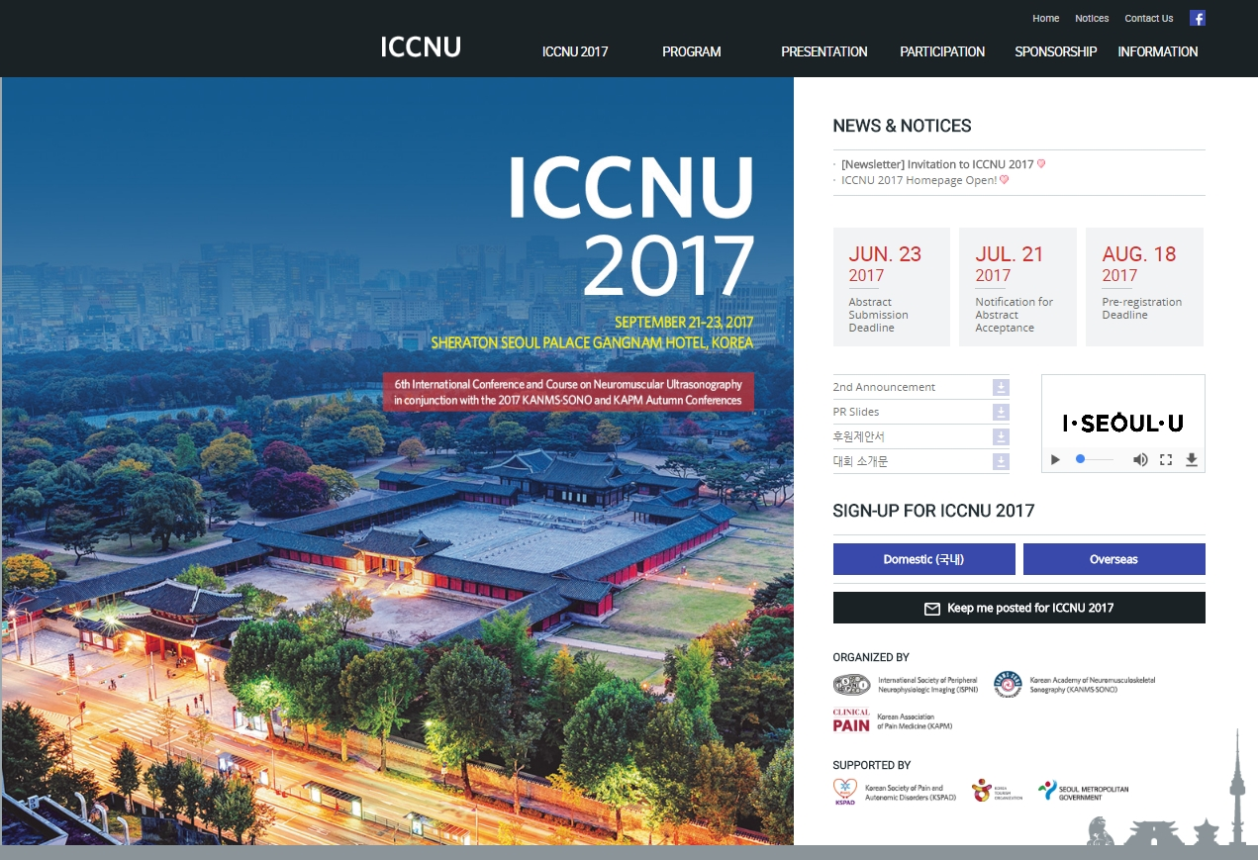
www.iccnu2017.org

